Slide 1
VIDEO COLORIZER USING AI-DEEP LEARNING TECHNIQUE
PRESENTED BY: M.DHIVYA
REGISTER NO: 730321243006
DEPARTMENT: ARTIFICIAL INTELLIGENCE AND DATA SCIENCE
3/21/2024 Annual Review

Slide 2
PROJECT TITLE
VIDEO COLORIZER USING ARTIFICIAL INTELLIGENCE AND DEEP LEARNING TECHNIQUE
3/21/2024 Annual Review

Slide 3
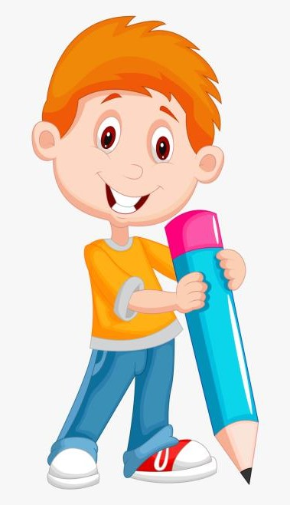

AGENDA
1.PROBLEM STATEMENT
2.PROJECT OVERVIEW
3.END USERS
4.OUR SOLUTION AND PROPOSITION
5.MODELLING APPROACH
6.RESULTS AND EVALUATION
7.CONCLUSION
3/21/2024 Annual Review

Slide 4

PROBLEM STATEMENT
Develop an AI-based video colorization tool that takes black-and-white videos as input and produces colorized versions of the same videos. The goal is to enhance historical or monochromatic footage by adding realistic colors while preserving the original content.
Key Requirements:
Input Format: The system should accept video files (preferably in the ‘*.mp4’ format) as input.
Colorization Process: The neural network should individually colorize each frame of the video.
Quality and Speed: The solution should strike a balance between colorization quality and processing speed.
Watermarking: Optionally, a watermark indicating AI colorization should be added to the output video.
Motivation: This project draws inspiration from existing work, such as the code by Sunita Nayak at BigVision LLC, which leverages OpenCV and neural networks for image colorization. The goal is to extend this capability to videos, making it accessible and user-friendly.
3/21/2024 Annual Review

Slide 5

PROJECT OVERVIEW
Its mission is to colorize and restore old images and film footage. DeOldify uses a combination of convolutional neural networks (CNNs) and generative adversarial networks (GANs) to achieve high-quality colorization for grayscale images and videos. The project is built on top of the PyTorch deep learning framework. Here are some key points about DeOldify:
Objective: Colorize and restore old images and videos.
Architecture: Utilizes GANs for image colorization.
Framework: Built on PyTorch.
3/21/2024 Annual Review

Slide 6

WHO ARE THE END USERS?
Consumers:
History buffs and genealogists
Filmmakers and videographer
Social media users and content creators
Creative hobbyists and families
Professionals:
Archivists and librarians
Educators
Documentarians
Stock footage companies
Other potential users:
Film restoration companies
Entertainment companies
Video editing companies
3/21/2024 Annual Review

Slide 7

YOUR SOLUTION AND ITS VALUE PROPOSITION
Solution:
Develop a video colorizer powered by OpenAI's machine learning models. This tool would allow users to upload black and white or faded color videos and receive a colorized version.
Here are some key features to consider:
Easy to Use Interface: Drag-and-drop functionality or a simple upload process for user-friendly experience.
Multiple Colorization Options: Allow users to choose from pre-defined color palettes, adjust color intensity, or even provide reference images for a specific style.
High-Quality Output: Utilize OpenAI's advanced models to generate realistic and accurate colorization while maintaining video resolution.
Batch Processing: Enable colorization of multiple videos at once for efficient workflow.
3/21/2024 Annual Review

Slide 8
Customization Controls: Offer granular control over specific aspects of colorization (e.g., sky color, skin tones) for users who desire more creative freedom.
Value Proposition:
Preserves History: Bring historical footage to life for a deeper understanding of the past.
Enhances Creativity: Offers filmmakers and content creators unique visual styles and storytelling possibilities.
Personalizes Memories: Allows users to breathe new life into old family videos and create lasting keepsakes.
Saves Time and Resources: Provides an automated and efficient solution compared to manual video colorization techniques.
Increases Accessibility: Makes historical or archival footage more engaging and accessible to a wider audience.
Target Markets:
Consumers (history buffs, genealogists, social media creators)
Professionals (archivists, educators, filmmakers, stock footage companies)
Businesses (film restoration companies, entertainment companies, video editing companies)
Competitive Advantage:
Leverage OpenAI's cutting-edge technology for superior colorization accuracy and quality.
Prioritize user-friendliness with an intuitive interface and diverse customization options.
Offer a range of pricing plans to cater to individual and professional needs.
By focusing on these aspects, a video colorizer powered by OpenAI can provide a valuable solution for various users, unlocking new creative possibilities and offering a unique way to experience and understand the past.

Slide 9

THE WOW IN YOUR SOLUTION
The "wow" factor in a video colorizer using AI and deep learning comes from a combination of technology and user experience:
For the Technology:
Unbelievable Accuracy: Imagine black and white footage coming to life with colors that feel natural and historically appropriate. AI can analyze content, understand context, and use its knowledge to paint a picture that goes beyond basic color application. This could include recognizing objects (like a red car or a blue sky) and applying those colors with high accuracy.
Creative Colorization Options: Go beyond just replicating reality. The AI could offer artistic color palettes inspired by different eras or allow users to colorize specific objects in unique ways. Imagine turning a black and white dream sequence into a vibrant dreamscape.
High-Definition Results: No more blurry, pixelated colorization. Deep learning can produce stunning, high-resolution colorized videos that retain all the detail and clarity of the original footage. Imagine seeing the subtle expressions on people's faces in a colorized historical film.
3/21/2024 Annual Review
9

Slide 10
For the User Experience:
Effortless Colorization: Drag and drop your video, choose your style, and let the AI do the magic. No complex editing software or color grading knowledge required.
Real-Time Previews: See a preview of the colorized video as you adjust settings, allowing for instant feedback and creative exploration.
Historical Reference Integration: Want your colorized video to be historically accurate? Provide the AI with reference photos from the same era for clothing styles, architecture, or natural landscapes to guide the colorization process.
Imagine this: You upload a grainy black and white home movie of your grandparents on their wedding day. The AI colorizes it, bringing their white dress and his black suit to life. You see the joy on their faces in a way you never could before. That's the "wow" factor – a tool that unlocks the past and connects you to it on a whole new level.

Slide 11
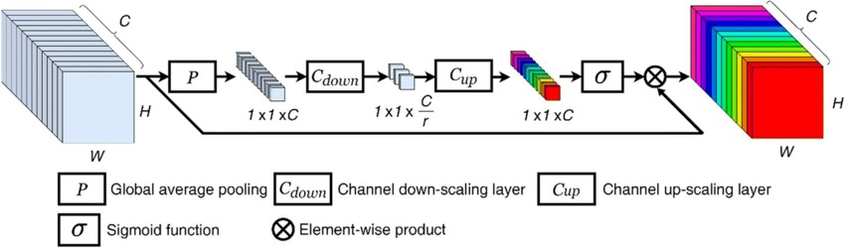
MODELLING
Teams cam add wireframes
3/21/2024 Annual Review
11

Slide 12
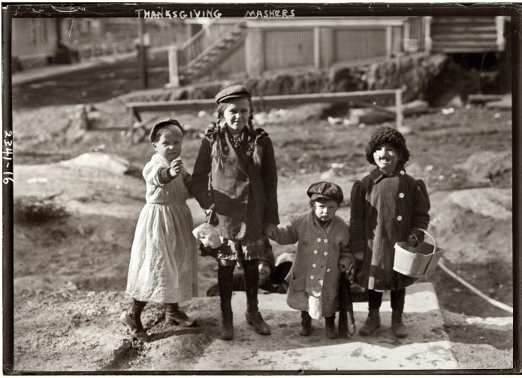
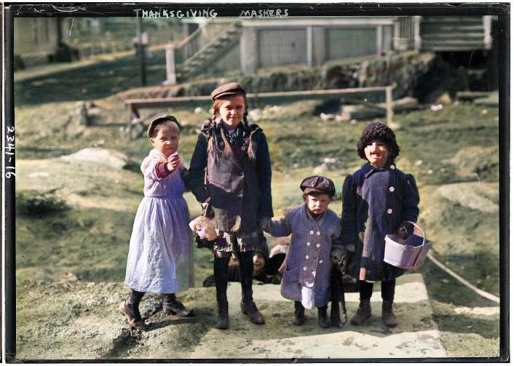
RESULTS
INPUT:
OUTPUT:
Demo Link:https://github.com/viyasha/TNSDC1.git
3/21/2024 Annual Review
12

